Slide 1
IS-456: Database Management Systems
Module 2: Database Architecture and Models-Relational and Normalization
Fall 2020
CityU
of Seattle
Farzin Bahadori

Slide 2
Topics
Database Architecture
Database Models
Business Rules
Translating Business rules into Data Model Components
The Entity Relational Model
The Object-Oriented Model
Big Data
NoSQL
Relational Database Model
Keys
CityU
of Seattle
Farzin Bahadori

Slide 3
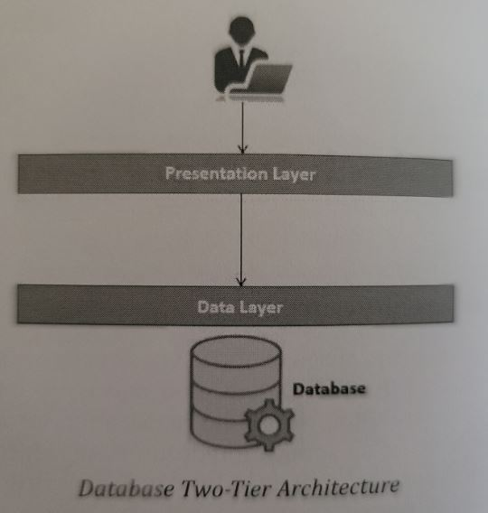
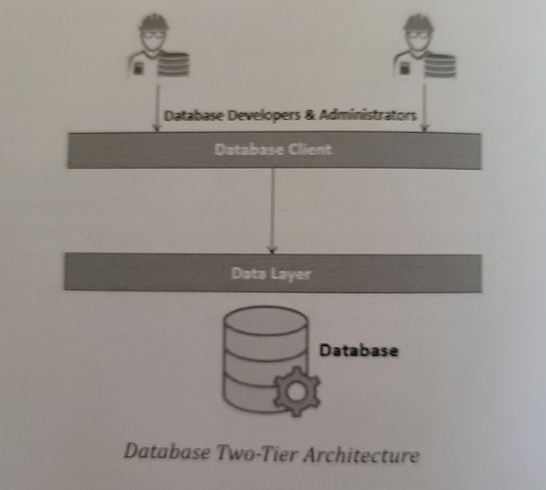
Database Architecture
Two-Tier architecture
Presentation Layer → Data Layer
CityU
of Seattle
Farzin Bahadori

Slide 4
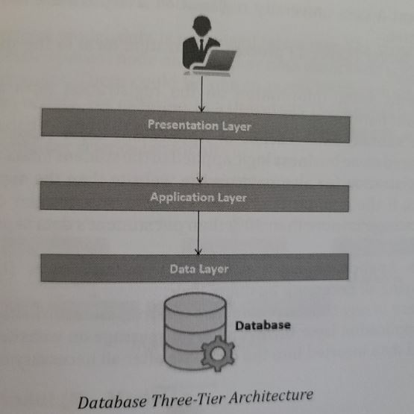
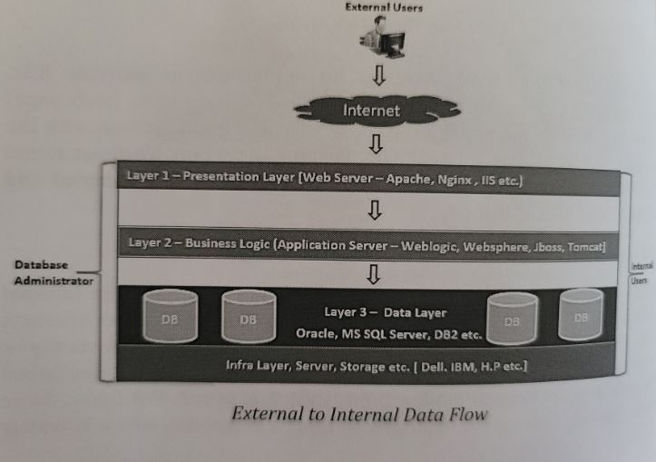
Database Architecture Cont.
Three Tier Architecture
Adding 1 more layer →Application Layer Data Flow
CityU
of Seattle
Farzin Bahadori

Slide 5
Data Models
Importance of Data Models
Basic Building Blocks
Attribute
Relationship →
Constraint
Business Rules
Translating Business Rules into Data Model Components
Naming Conventions
One-to-many (1:M)
Many-to-many (M:N)
One-to-one (1:1)
CityU
of Seattle
Farzin Bahadori

Slide 6
Data Models Cont.
Hierarchical Model (H-R Model)
Network Model (N-Model)
Entity-Relational Model (E-R Model)
Relational Model (R-Model)
The Object-Oriented Model
Object/Relational and XML
CityU
of Seattle
Farzin Bahadori

Slide 7
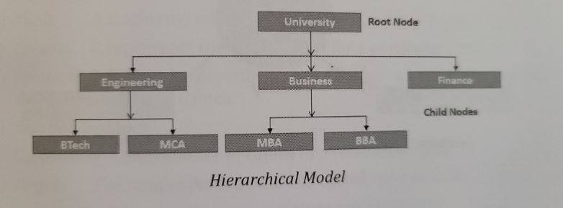
Hierarchical Model
Was developed in 1960 to manage large amount of data for complex manufacturing Projects (Apollo Rocket that landed on the moon in 1969).
Upside-down tree
Contains: Levels and Segment
The Hierarchical Model → (1:M) (relationship between “parent” and “children”)
Example:
CityU
of Seattle
Farzin Bahadori

Slide 8
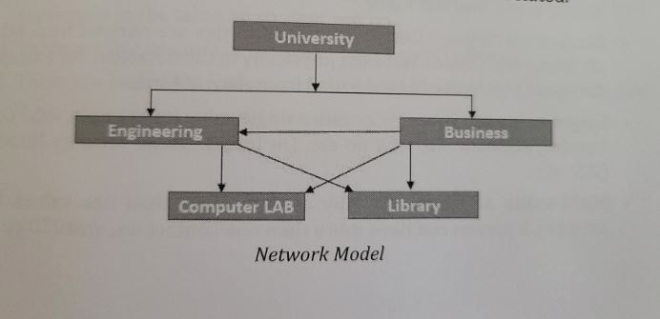
Network Model
Was created to represent complex data relationships to improve database performance
1:M (allows a record to have more than one parent)
Standard database
Schema
Subschema
Data manipulation language (DML)
Data definition language (DDL)
Example of N-Model:
CityU
of Seattle
Farzin Bahadori

Slide 9
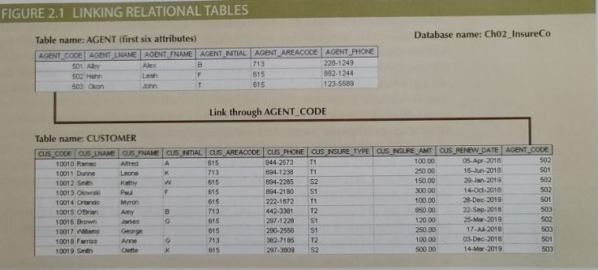
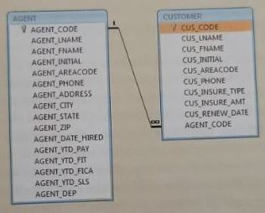
The Relational Model
Was introduced in 1970 by Codd of IBM
Represented a major breakthrough for both users and designers
Like: Produced the “Automatic Transmission” database to replace the “Manual Transmission” databases
Mathematical concept known as “Relation” → “Table” which has row and column
Row → tuple Column → attribute
CityU
of Seattle
Farzin Bahadori

Slide 10
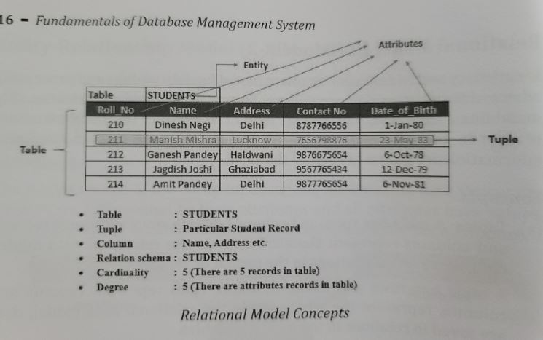
The Relational Model Cont.
Concepts:
Tables
Tuple
Column
Relation Schema
Relation Instance
Cardinality
Degree
The table name is STUDENTS, also called an “Entity” where all student’s data is organized in a standard format
Each individual student record called Tuple
CityU
of Seattle
Farzin Bahadori

Slide 11
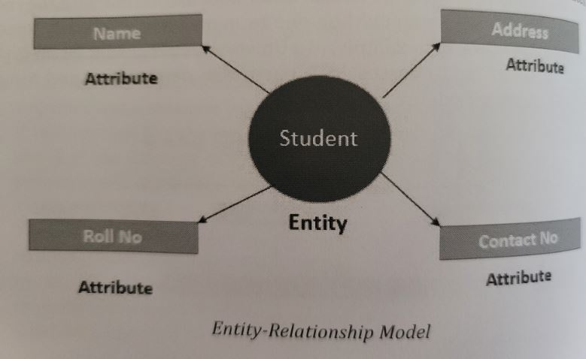
The Entity Relational Model
It is a graphical tool where the entities and their relationships are pictured
It was introduced by Peter Chen in 1976
Relational data model and ERM combined to provide the foundation for structured database design.
ERM are normally represented in an entity relationship diagram (ERD) for graphical representations to model database components.
Entity
Attributes
Relationships
CityU
of Seattle
Farzin Bahadori

Slide 12
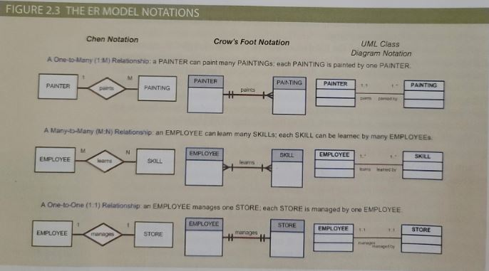
CityU
of Seattle
Farzin Bahadori

Slide 13
The object Oriented Model
In the Object Oriented Data Model (OODM), both data and its relationships are contained in a single structure known as an “object”.
Abstraction of real-world entity
Attributes describe the properties of an object
Classes: collection of similar objects with shared structure (attributes) and behavior (methods).
Methods: represents a real-world action.
Class hierarchy
Inheritance
Unified Modeling Language (UML)
CityU
of Seattle
Farzin Bahadori

Slide 14
Big Data and NoSQL
Big Data refers to a movement to find new and better ways to manage large amounts of web- and sensor-generated data and derive business insight from it with a cost management.
Basic characteristics of Big Data (3Vs):
Volume
Velocity
Variety
Some of the most frequently used Big Data technologies are:
Hadoop
Hadoop Distributed File System (HDFS)
MapReduce
NoSQL (Search in Amazon, Facebook Message, You Tube Video, or search in Google Map)
Farzin Bahadori

Slide 15
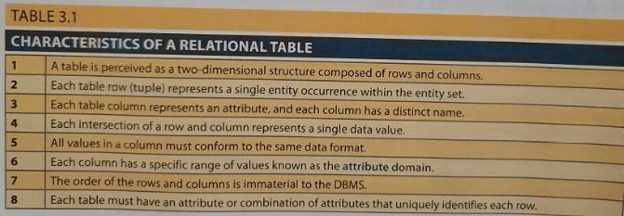
A logical View of Data
Tables and their characteristics
CityU
of Seattle
Farzin Bahadori

Slide 16
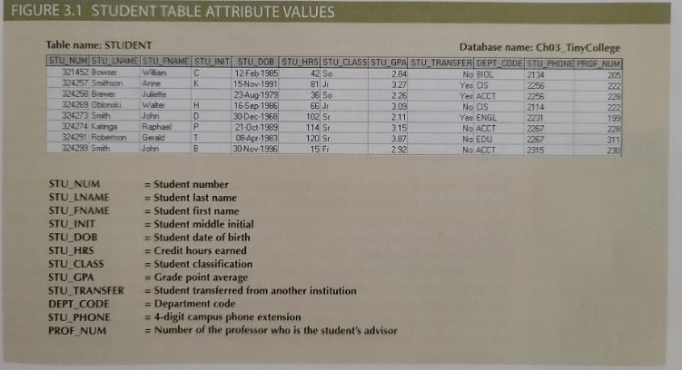
A logical View of Data Cont.
CityU
of Seattle
Farzin Bahadori

Slide 17
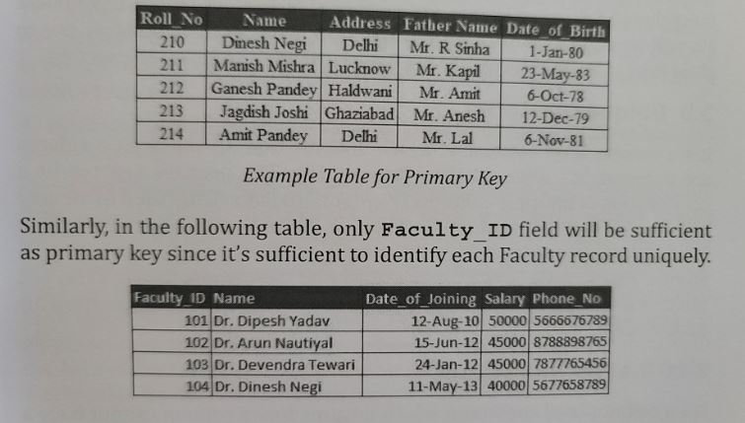
Keys
Dependencies
Types of Keys
Candidate key
Composite key
Primary key
Foreign key
Key attribute
Super key
Secondary key
Entity integrity
CityU
of Seattle
Farzin Bahadori

Slide 18
Summary
Database Architecture
Database Models
Object oriented model
RM and ERM
Big data and NoSQL
Keys
CityU
of Seattle
Farzin Bahadori

Slide 19

CityU
of Seattle
Farzin Bahadori

Slide 20
Resources
Mukesh Negi, (2019): Fundamental of Database Management System
Coronel C., Morris S., (2019): Database Systems, Design, Implementation, & Management
CityU
of Seattle
Farzin Bahadori

